Slide 1
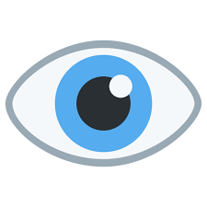
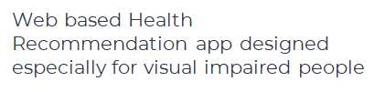
THIRD EYE

Slide 2
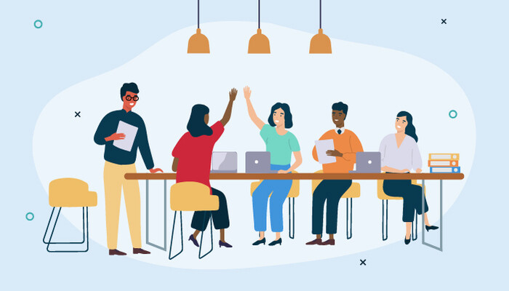
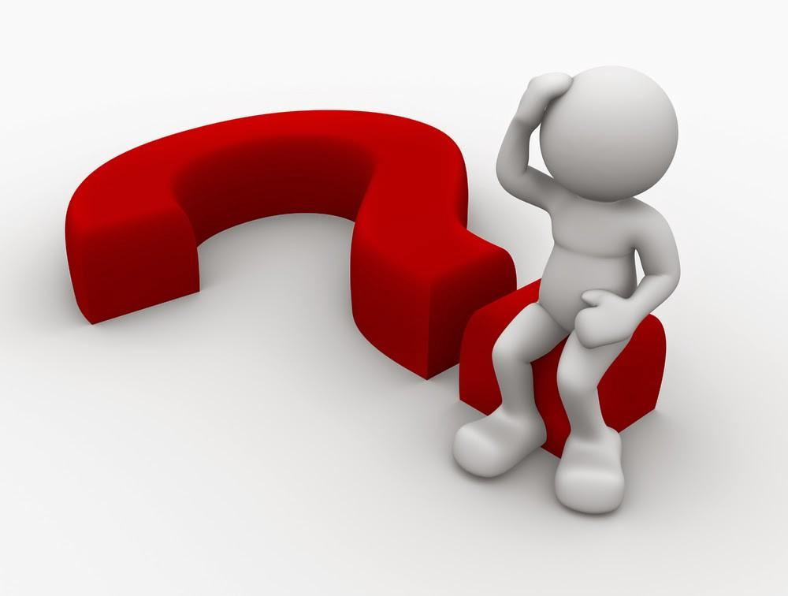
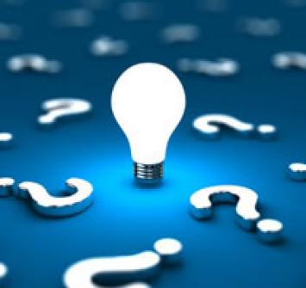
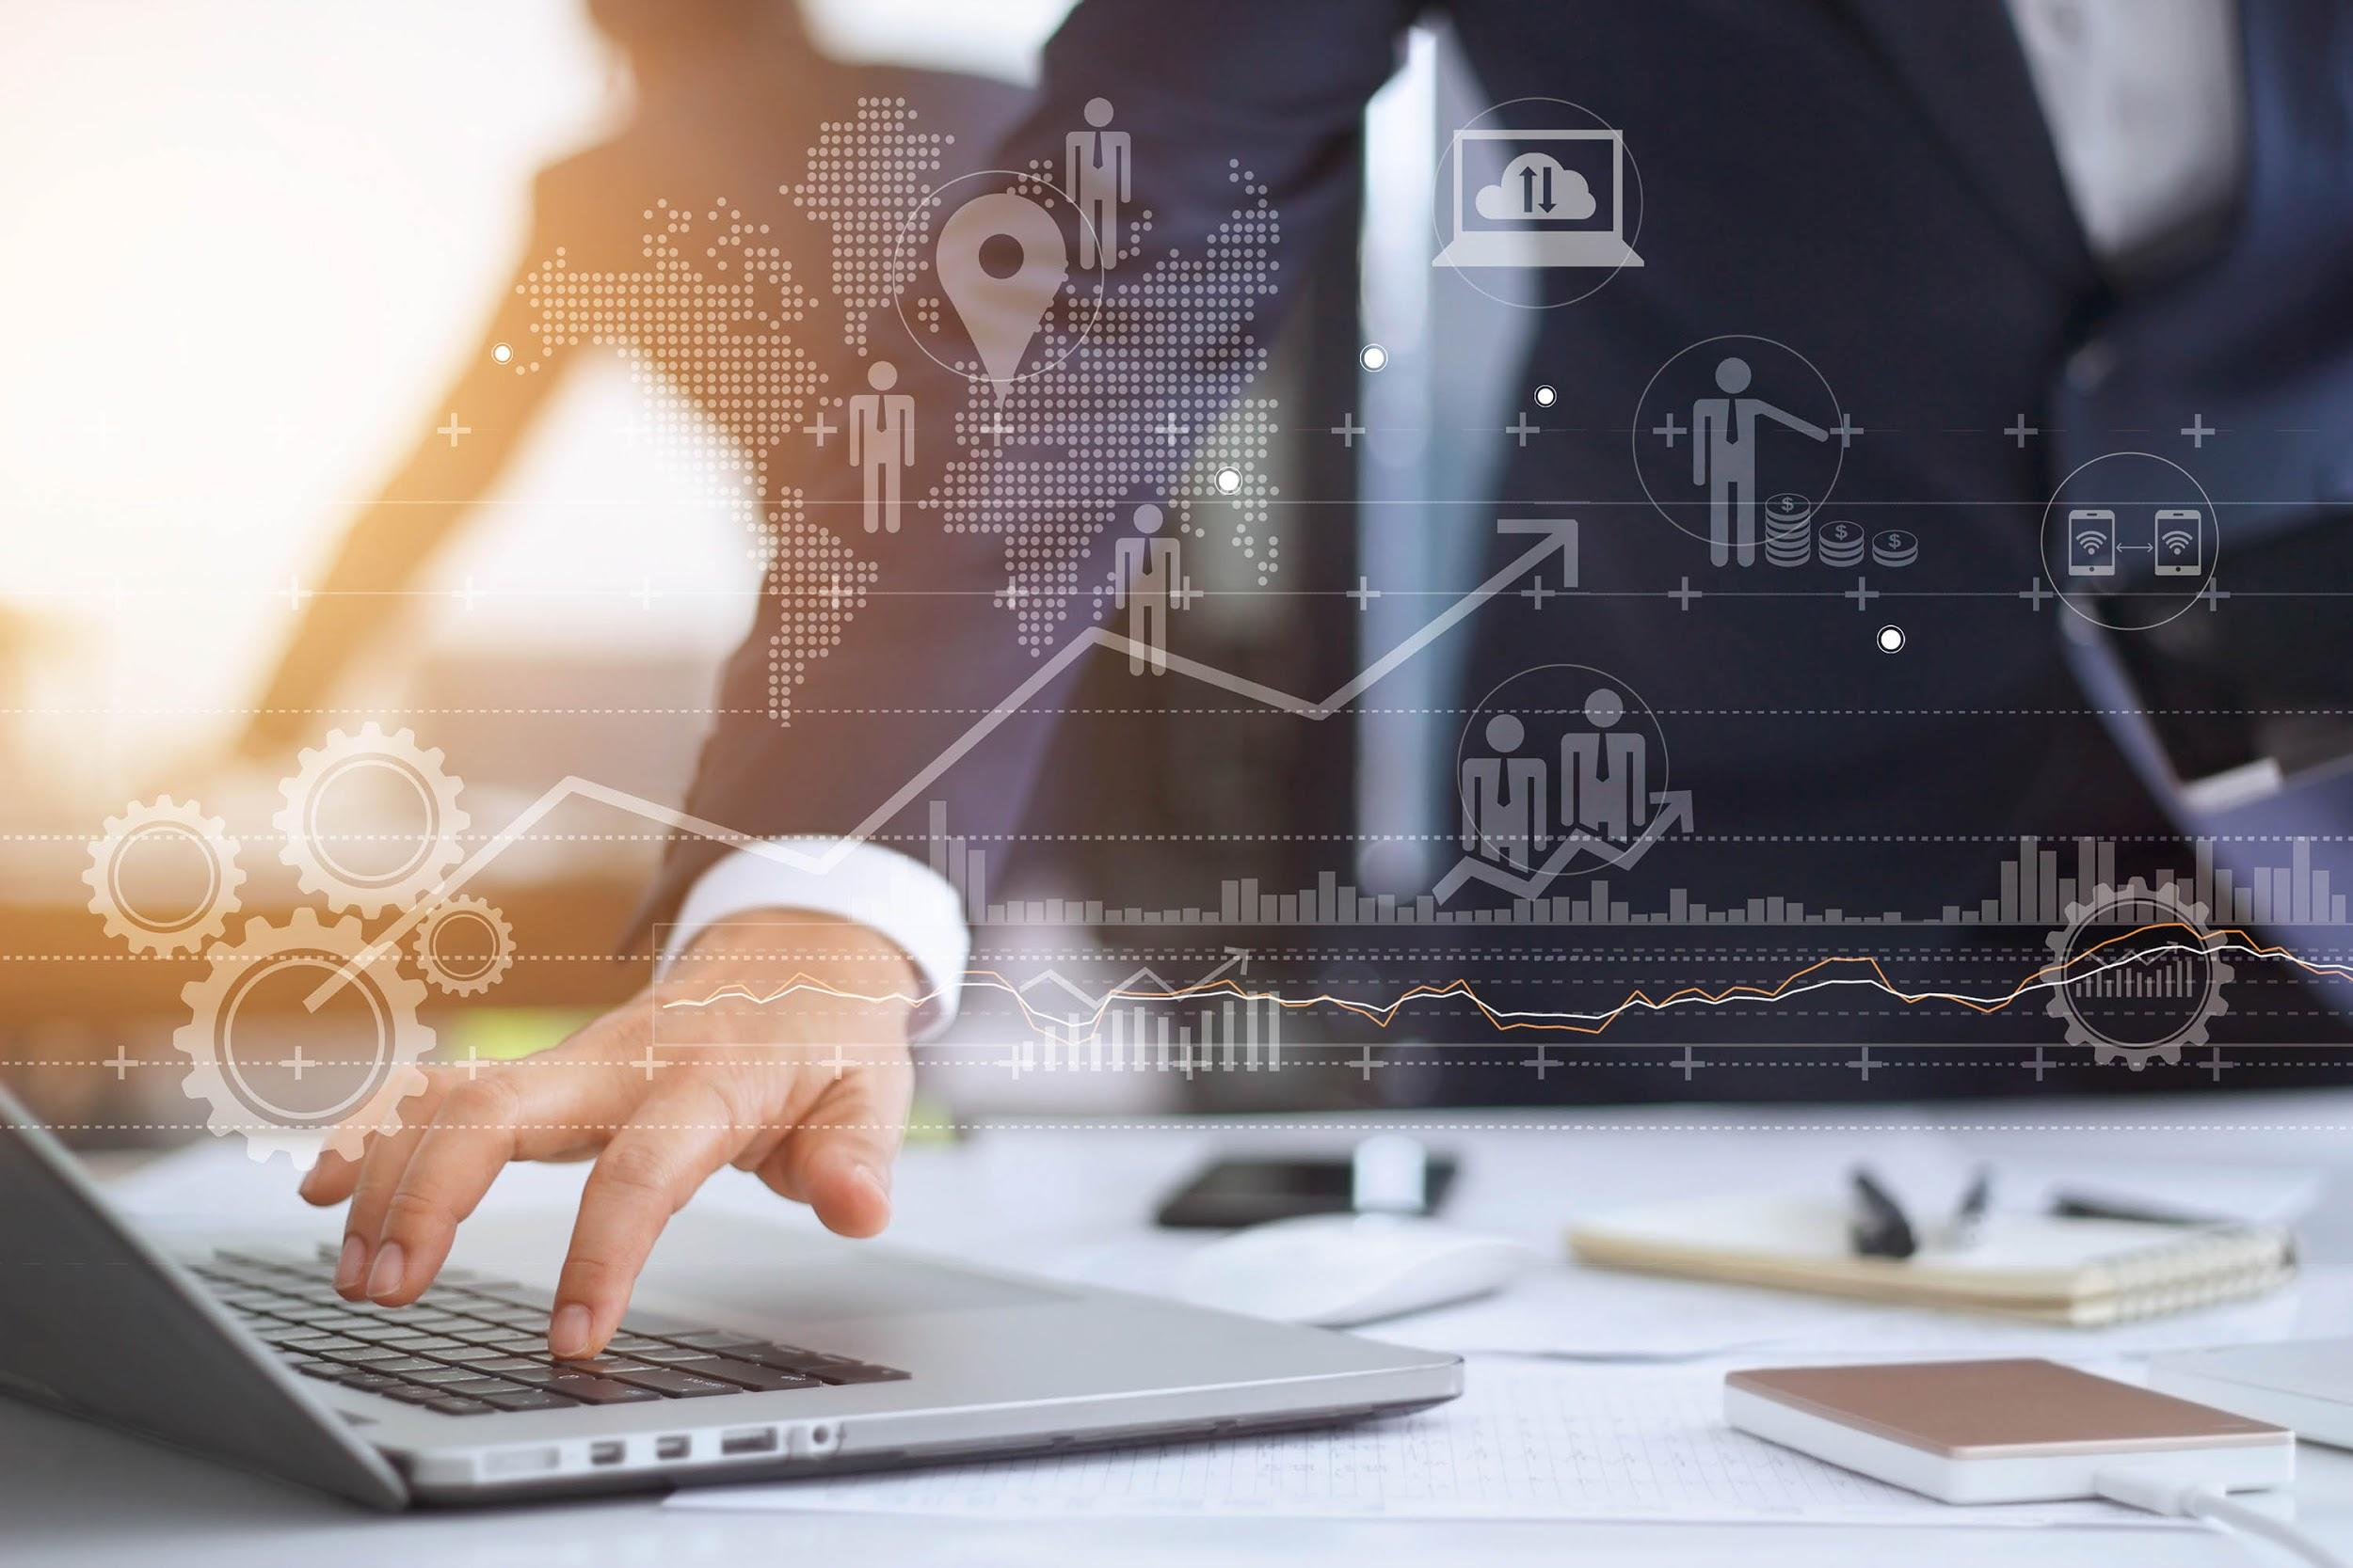
TABLE OF CONTENTS
01.
02.
03.
04.
OUR TEAM
PROBLEM
SOLUTION
BUSINESS

Slide 3
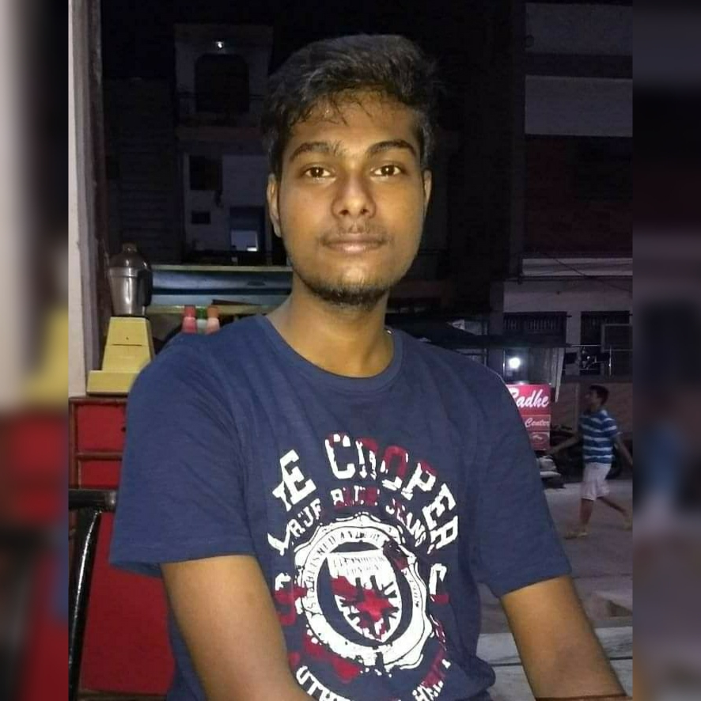
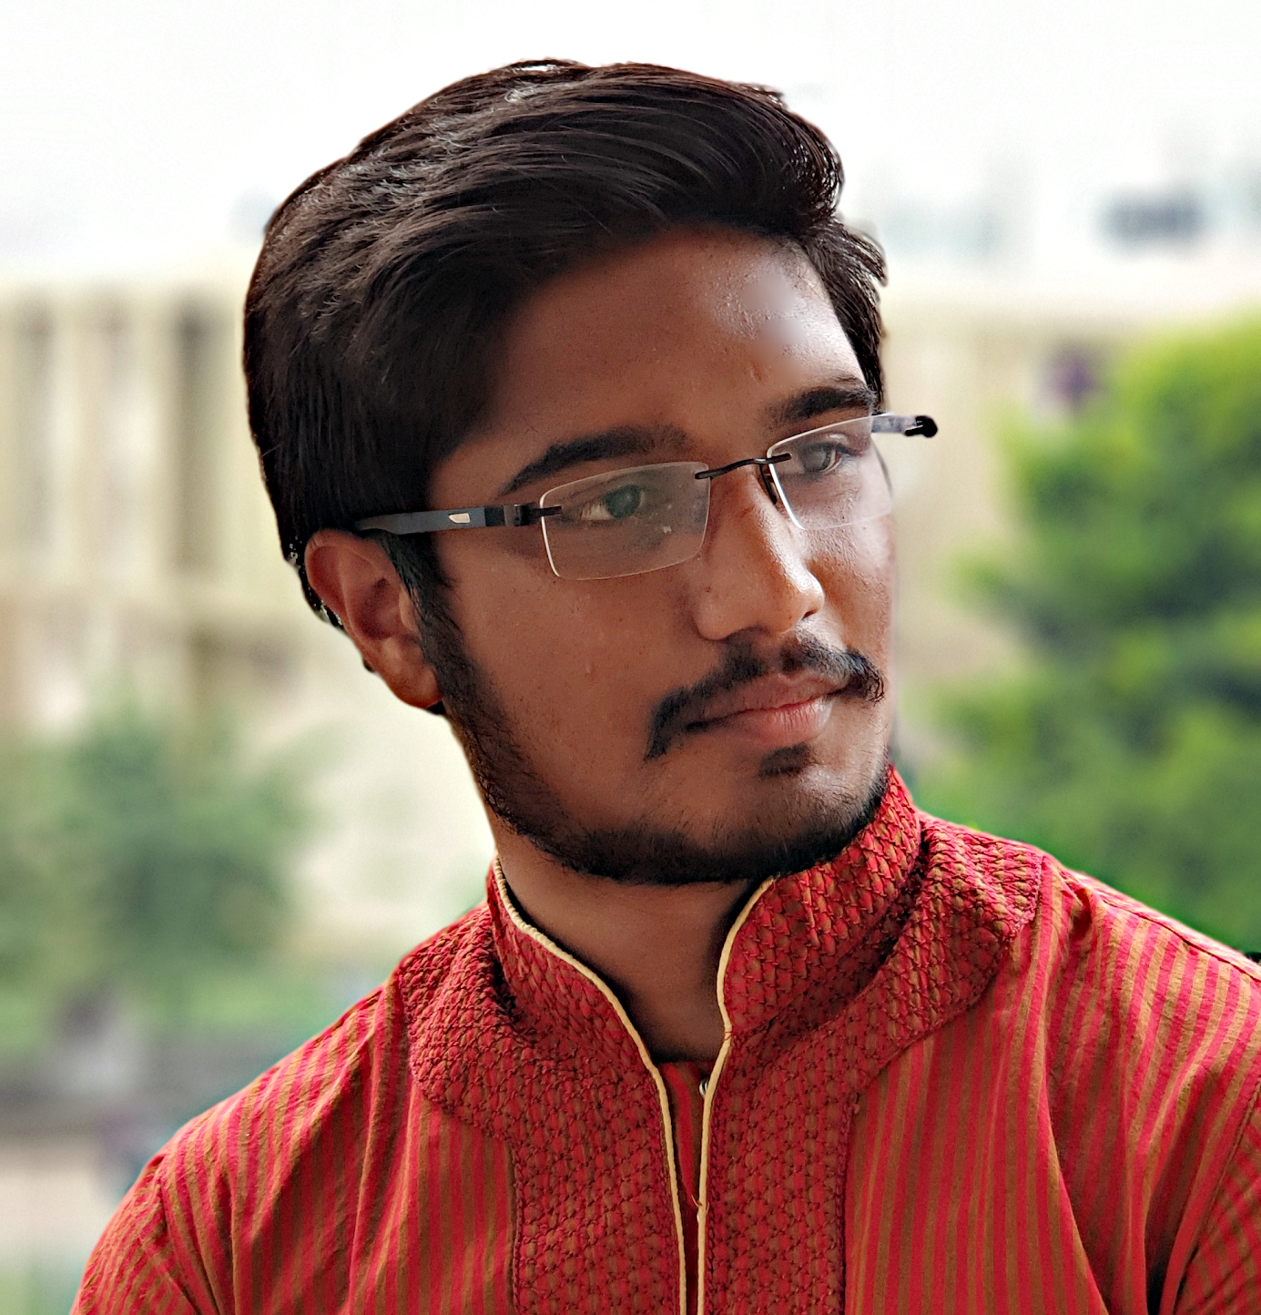
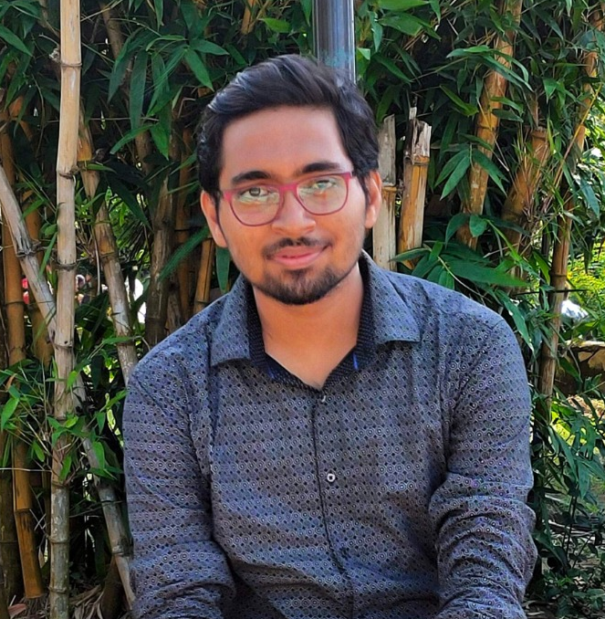
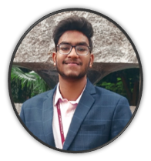
TEAM MEMBERS
VIKASH KUMAR
RIBHU BHOWMICK
MAYANK MRIDUL
YASH GUPTA
We are a group of 4 members, currently pursuing B.tech in Information Technology Engineering from KIIT Deemed to be University, Bhubaneswar. We are in our pre-final year of Bachelor's degree.

Slide 4
PROBLEM
Create Solutions to deal with these two major challenges faced by the patients:
1. Enabling a patient-centered information exchange system.
2. Personal medical assistant.

Slide 5
SOLUTION
We have designed a prototype of a web-based application that works on voice recognition with the help of an automated Chat bot. It is designed specifically for blind people who has an access to Internet facilities, but can be helpful for everyone who is in search of doctors for health issues. The voice recognition system is used for vocal communication with the patient and recommend the best available doctor based on answers to the bot’s predefined questions, filtered by location of the patient and feedbacks of patients in his/her locality.

Slide 6
SWOT ANALYSIS
S
W
O
T
STRENGTHS
WEAKNESSES
This will be specifically helpful for visually impaired persons
Difficult to implement for a developing country like India where Internet facility has not yet reached to a considerable percentage of population.
OPPORTUNITIES
THREATS
Connects patients with doctors and clinics around a given area
Chances of fraud by certain individuals

Slide 7
INTRODUCTION
The current pandemic has pushed many businesses across different industries to reflect on and reconsider their relationship with technology, and how it can be better utilised to enhance consumer interaction. With all of us being confined to our homes, we have seen a surge in the use of innovative tech to help keep us connected, such as using voice and messaging experiences to help stay closer to our families. But voice technology and chatbots have more potential to advance and transform industries outside of the consumer space such as healthcare. And while using such technologies is not entirely new to many healthcare businesses and professionals, COVID-19 has revealed the limitations of our current healthcare system and highlighted the areas that would benefit from more advanced technology.

Slide 8
PATIENT VIEW - DOCTOR VIEW
PATIENT VIEW
DOCTOR VIEW
My profile
Chat bot communication
Manual Doctor Search
Upcoming appointments
Nearby Patients
My profile
Upcoming Appointments
Manual Doctor Search
Messages
Discussion Forum

Slide 9
PRODUCT OVERVIEW
Search doctors
My profile
HOW CAN WE HELP YOU?
Chatbot
Appointments
Nearby Patients
Messages
Discussion forum

Slide 10
TECHNOLOGY STACK
DATABASE MANAGEMENT (MySQL, NodeJs, Mongodb)
ARTIFICIAL INTELLIGENCE (NLP and IVRS )
MACHINE LEARNING (Python with its libraries and Sklearn)
WEB DEVELOPMENT (Html, Css, Bootstrap, Js)

Slide 11

DATABASE
The importance of the data collection and it’s analysis leveraging Big Data technologies has demonstrated that the more accurate the information gathered, the sounder the decisions made,and the better the result that can be achieved.
Data collection is the ongoing systematic process of gathering,analysing and interpreting various types of information from various sources.
Data is divided into two types:
1.Quantitative:-in the form of number, e.g.percentages,comparison,etc.
2.Qualitative:-in the form of words,e.g.description of quality,appearance,etc.
Data collection in healthcare allows health system to create holistic views of patients,personalize treatments, advance treatment method,improve communication between doctors and patients, and enhance health outcomes. Data scraping will be done from various websites using node js.

Slide 12
Artificial Intelligence
Artificial intelligence is making waves in healthcare. More than 40 percent of healthcare executives consider it the technology that will have the greatest impact on their organizations within the next three years. Conversational agents (CA) are artificial intelligence (AI) driven applications that can process naturalist text and speech to deliver personalized interactions with users, i.e. chatbots, voice assistants, embodied conversational agents, virtual assistants and interactive voice recognition systems (IVRS).
The potential for voice technology could lead to even more effective healthcare in the public and private space. For instance, we’ve seen how services such as Amazon Alexa, Google Assistant and Siri have impacted the day-to-day lives of people living with disabilities. Using voice assistant technology could, therefore, help people with disabilities have better access to healthcare services and help them better engage with healthcare professionals and businesses.
A chatbot solution, which will be powered by an AI engine and driven by speech recognition,natural-language processing, enables real-time visually impaired patients-centered collaboration and learning from each interaction. The tool helps visually impaired people with everything from finding a doctor and scheduling appointments to outpatient monitoring and much more. We will collect the data from the users with the help of chatbot and voice recognition techniques and then proceed to the machine learning procedure.

Slide 13
Machine Learning
The value of machine learning in healthcare is its ability to process huge data sets beyond the scope of human capability, and then reliably convert analysis of that data into clinical insights that aid physicians in planning and providing care, ultimately leading to better outcomes, lower costs of care, and increased patient satisfaction.
So, by the use of machine learning, we firstly want to predict patient’s disease and then cluster the same diseased people into the same group. For that, K-Nearest Neighbor (KNN) machine learning algorithm is used for fast classification of big data and accurate prediction of disease. Because medical data is increasing day by day so usage of that for predicting correct disease is crucial task but processing big data is very crucial in general so data mining plays very important role and classification of large dataset using machine learning becomes so easy. Clustering is an unsupervised machine learning technique that groups observations (e.g., patients) according to similarities among measured characteristics. There are a variety of approaches to clustering.We will be using, Density-based clustering algorithms, which identify areas of varied density within a dataset and group together observations that make up areas of high density. One popular density-based clustering algorithm is ordering points to identify the clustering structure (OPTICS), which is an extension of the earlier density-based spatial clustering of applications with noise (DBSCAN) algorithm. After patterning the patients ini same group, we will allocate the best doctors according to their specialization rated upon feedback by the users only.

Slide 14
Web Development
HTML,CSS,and Javascript are at the heart of Front End development by using this language we design all the Front End part and we design a feedback collector form which collects the feedback from the patient and store it into the database accordingly we can allocate the doctors.
Our support system can be employed to help patients with chronic condition such as blindness and support them in the management of their conditions. Thus it, promotes patients’ personal responsibility and encourages their conditions.
For the doctors, we have planned for a chatbox where they can connect with other doctors for suggestions. Also, a discussion forum is designed for exchange of views by medical professionals.

Slide 15
OUR PLANS
PREMIUM
BASIC
Chatbot service
Virtual Help Desk
24X7 Availability
Connect nearby
Real time chat
Native language
Chatbot service
Virtual Help Desk
24X7 Availability
Connect nearby

Slide 16
BUSINESS

Slide 17
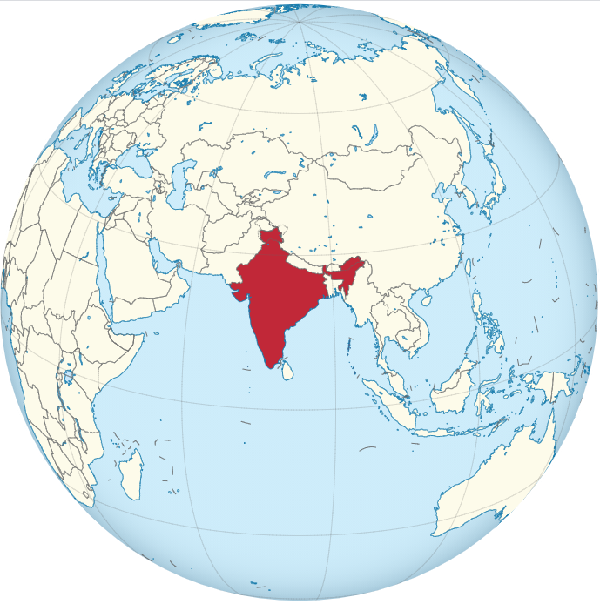
MARKET SIZE
Currently, India has around 12 million blind people which makes India home to one-third of the world's blind population.
About 285 million people are visually impaired worldwide: 39 million are blind and 246 million have low vision (severe or moderate visual impairment).

Slide 18
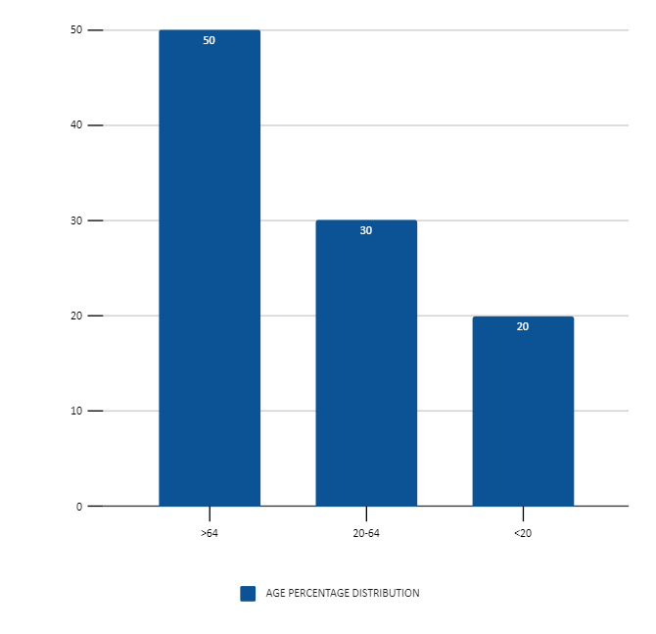
TARGET
Percentage Age Distribution
ESTIMATED USERS
3000000
Around, 25 percent of 12 million patients has access to internet facility

Slide 19
COMPETITORS
 | FOUNDED | EMPLOYEES | Business Model | Headquarters
Ioptyc ( product of Nexart ) | 2019 | 2-10 | B2B/ B2C | Trivandrum, Kerala
Torchit’s vision ( enabling assistive mobility and accessibility ) | 2016 | 20-40 | B2B/ B2C | Ahmedabad, Gujarat, India
Annie ( product of Thinkerbell Labs ) | 2016 | 2-10 | B2B/ B2C | Bangalore, Karnataka

Slide 20
BUSINESS MODEL
ASSESSMENT
MARKETING
A good execution can help an ample amount of people.
Social media, Digital marketing.
TECHNOLOGY
TRAINING
AI, Machine Learning, Web Development
Data collection and a good ML model will give a good result.

Slide 21
12,000,000
Number of visually impaired people who can be benefitted from this product right now

Slide 22
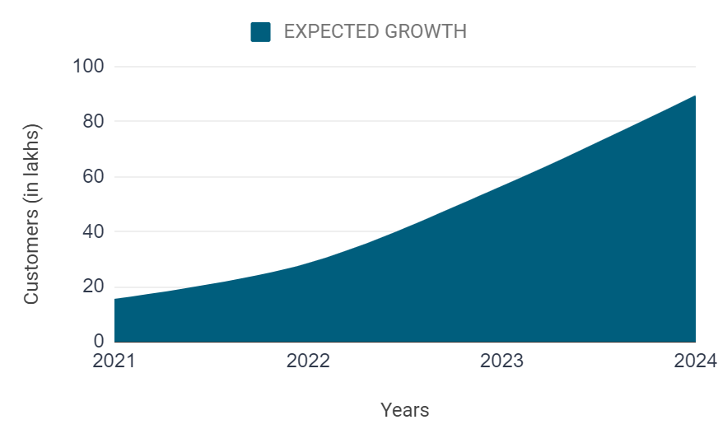
PREDICTED GROWTH

Slide 23
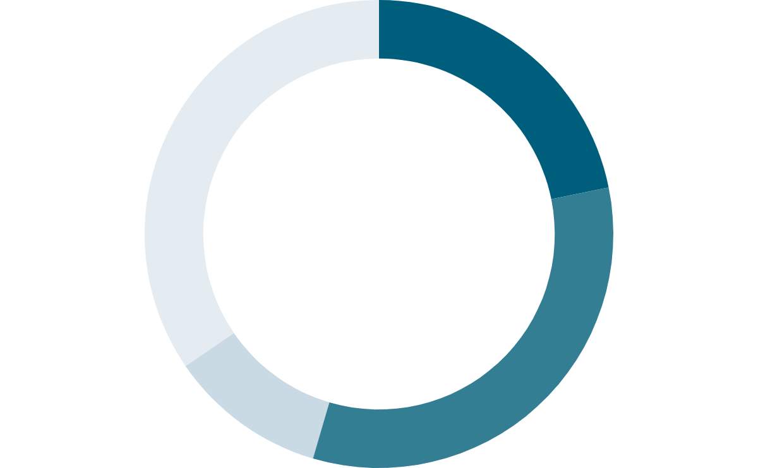
TIME ESTIMATION
35%
22%
BACK END
DESIGN
Creating ML model and handling the database
Designing the website view
10%
33%
INTEGRATION
FRONT END
Integrating all the things in one platform
Making of chatbot and basic user experience features

Slide 24
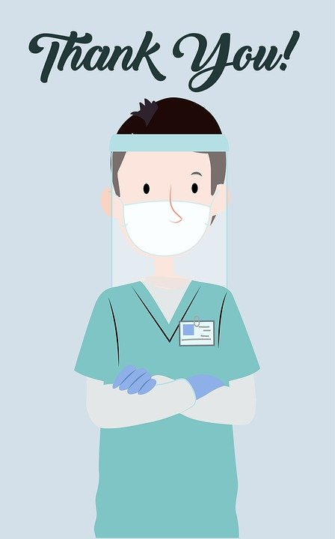

Please keep this slide for attribution.

